Slide 1
Globlization and MVC Async
Globalization Concept
Globalization in MVC
Asynchronous in C#
Using Async in MVC
September 6, 2016

Slide 2
Globalization and Localization Concept
Globalization is the process of designing the application in such a way that it can be used by users from across the globe (multiple cultures).
Localization, on the other hand, is the process of customization to make our application behave depending on the current culture and locale. These two things go together.
Globalization is about internationalizing applications: the application supports number and date formats depending on the culture
Globalization (Internationalization) It is a process of creating an application that supports localized user interfaces. Localization = translation . It is the process of translating the applications into different languages.
Cultures and Regions- The world is divided into multiple cultures and regions, and applications have to beware of these cultural and regional differences. A culture is a set of preferences based on a user’s language and cultural habits. Some examples are en-AU, en-CA, en-GB, and en-US for the English language in Australia, Canada, United Kingdom, and the United States

Slide 3
Globalization and Localization Concept in C#
CultureInfo class - The most important class in the System.Globalization namespace is the class CultureInfo. It represents a culture and defines calendars, formatting of numbers and dates, and sorting strings that are used with the culture.
RegionInfo clas - represents regional settings (such as the currency) and shows if the region is using the metric system. In the same region, you can use multiple languages.
Types of Culture
Invarient
Neutral
Specific
Invariant Culture - Should be used for storing data in a culture independent way. Should not be used for User Interface elements. Has no country/regionEg:CultureInfo ci = CultureInfo.InvariantCulture

Slide 4
Globalization and Localization Concept in MVC
MVC application supports Globalization and Localization
Steps –
Create new MVC project / open an existing project
Add new folder into solution as LocalResources or with other name
Add new resource file
Define the current culture

Slide 5
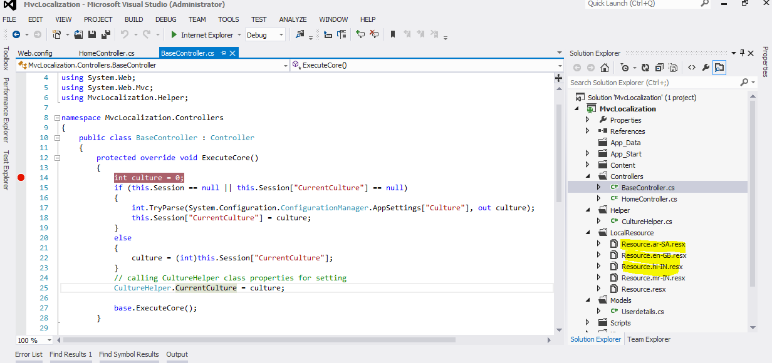
Example of Globalization

Slide 6
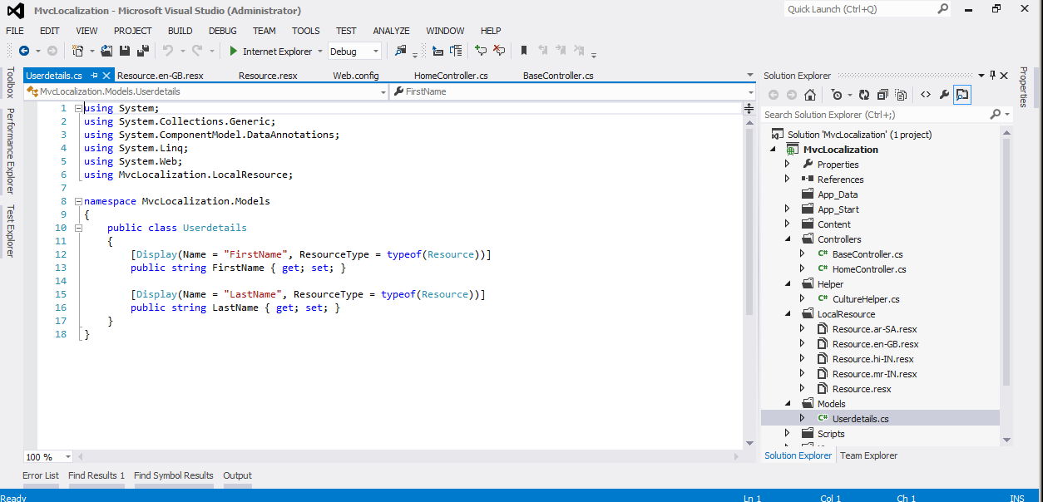
Example of Globalization

Slide 7
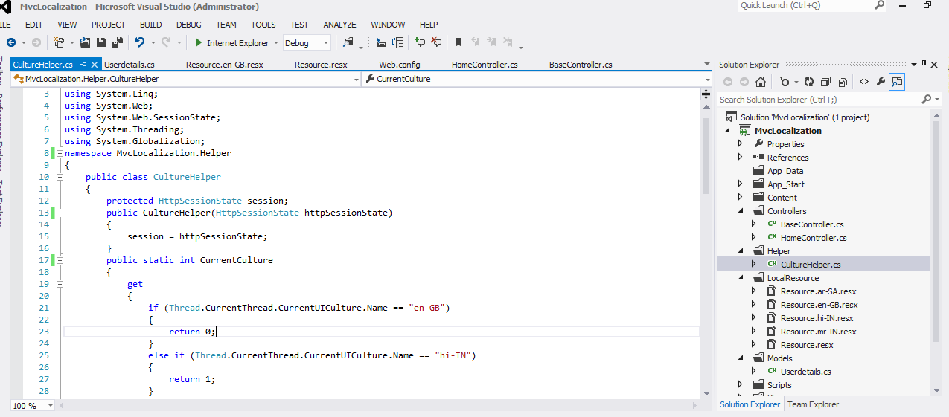
Example of Globalization

Slide 8
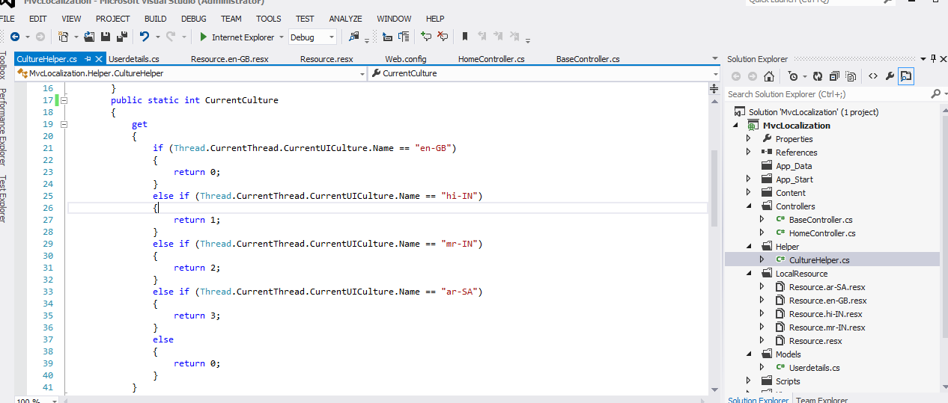
Example of Globalization

Slide 9
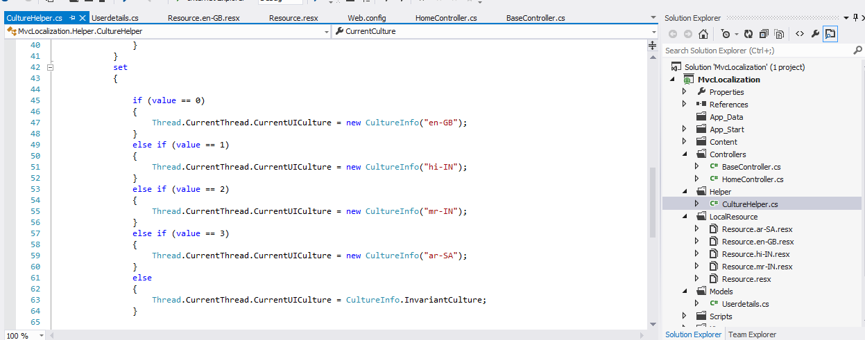
Example of Globalization

Slide 10
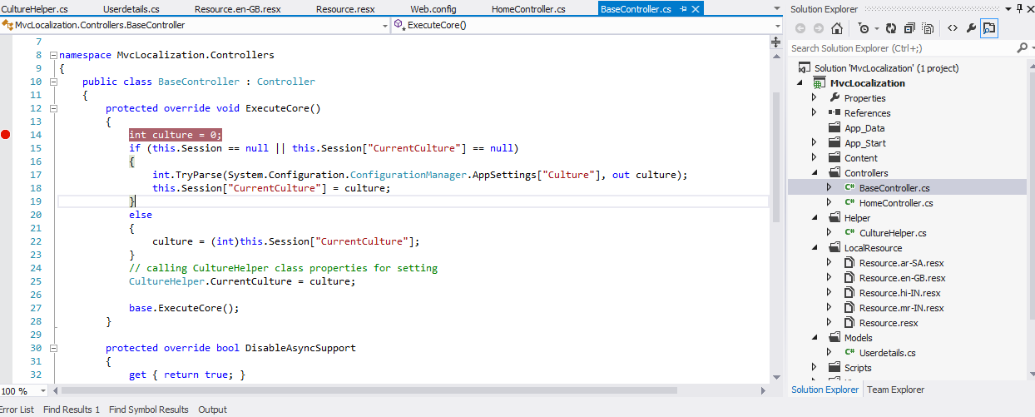
Example of Globalization

Slide 11
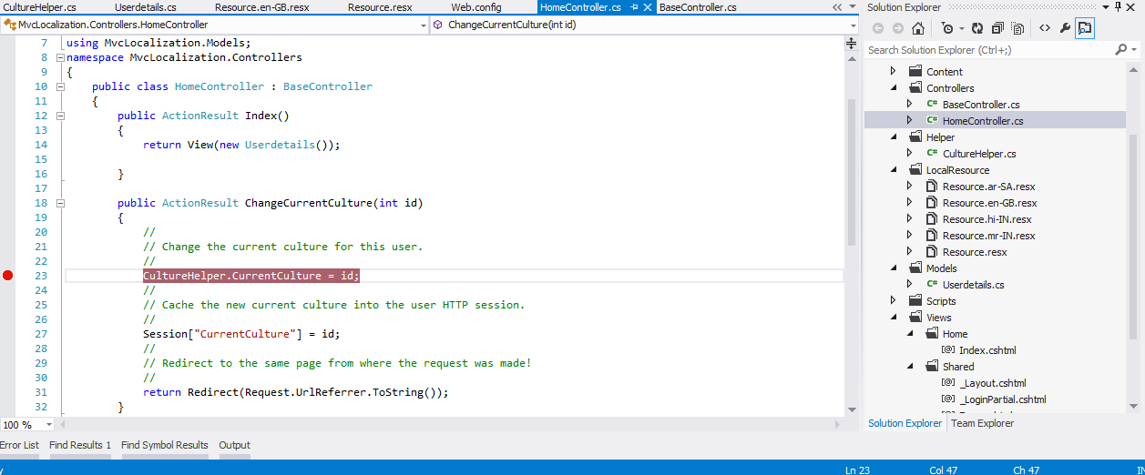
Example of Globalization

Slide 12
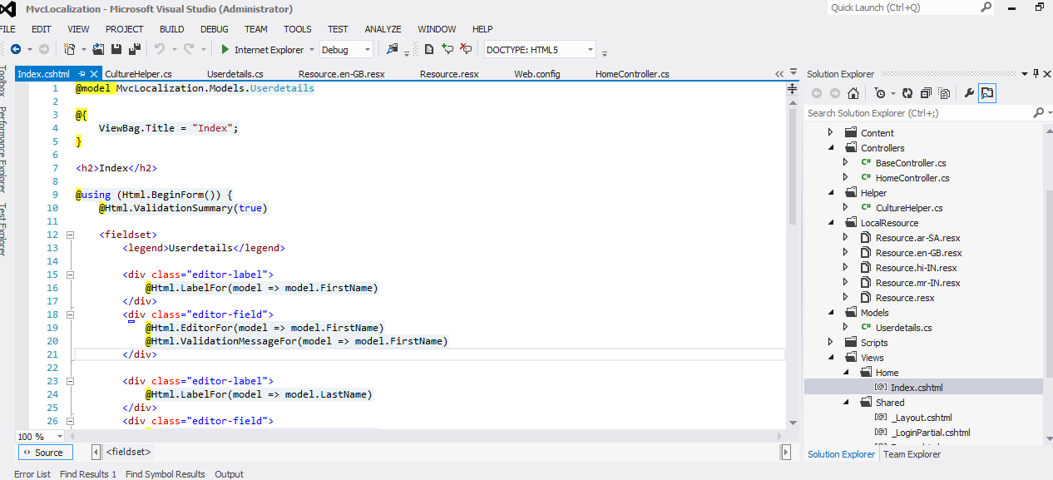
Example of Globalization

Slide 13
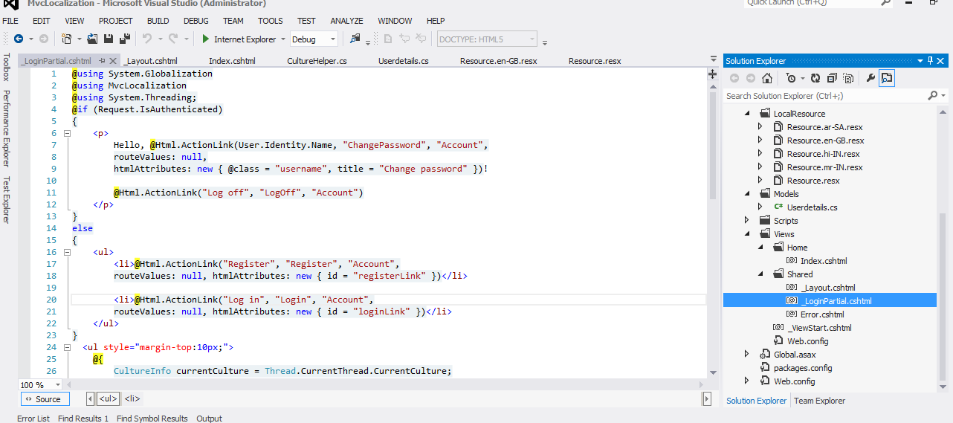
Example of Globalization

Slide 14
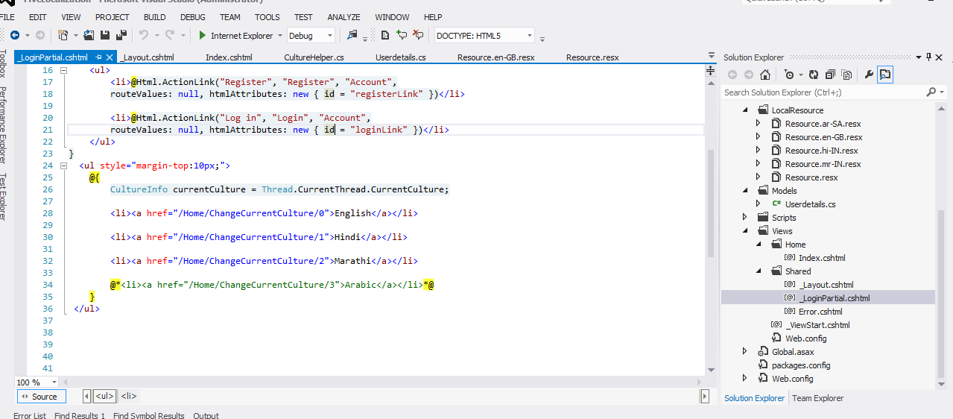
Example of Globalization

Slide 15
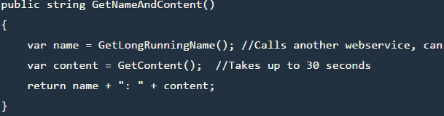
Asynchronous programming in C#
What is Asynchronous Programming?
Asynchronous programming is writing code that allows several things to happen at the same time without "blocking", or waiting for other things to complete.
This is different from synchronous programming, in which everything happens in the order it is written.
Synchronous C# method:

Slide 16
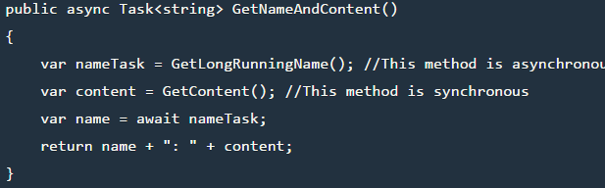
Asynchronous programming in C#
With .NET asynchronous programming, we can modify this method :
We marked the method as async. This tells the compiler that this method can run asynchronously.
We used the await keyword on the nameTask variable. This tells the compiler that we will ultimately need the result of the GetLongRunningName() method, but we don't need to block on that call.
We changed the return type to Task<string>. This informs the caller method that the return type will eventually be string, but not right away and that can do other things while GetLongRunningName() is processing.

Slide 17
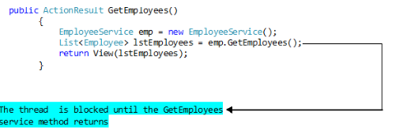
Asynchronous programming in MVC - Example
It’s simple to implement asynchronous action methods using the await and async keywords in.NET 4.5.
The following action method returns a List of employees from the database using a service call. Since fetching all the employees may take a considerable amount of time we can implement this action method as an asynchronous method.

Slide 18
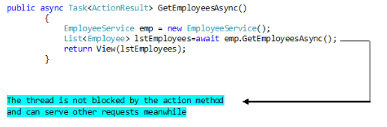
Asynchronous programming in MVC - Example
In the above method the control does not return back to the calling method until the GetEmployees() web service method completes execution. We can avoid this wait time by implementing the action method asynchronously as below.
If you observe there are only three differences in the asynchronous and synchronous action methods.
In the asynchronous method we are wrapping the return type in a Task while in a normal synchronous method we just return an ActionResult type.
The asynchronous method uses the async keyword in its declaration.
The asynchronous method uses the await keyword while making a method call that is expected to take a while to complete.

Slide 19
Asynchronous programming in MVC - Timeout
The action method may take to long to execute you can set the timeout using the AsyncTimeout which sets the timeout period in milliseconds. Following method signature sets the timeout of the action method to 200 milliseconds

Slide 20
Asynchronous programming in MVC
Demo

Slide 21

Thank You!
Name
Vighnesh Ambekar
Mobile: +1 XXX
Desk: +1 XXX
Vighnesh.ambekar@xoriant.com
www.xoriant.com
India
Mumbai
4th Floor, Nomura
Powai , Mumbai 400 076
Pune
5th Floor, Amar Paradigm
Baner, Pune 411 045
Kolkata
2B, 12th Floor, Tower ‘C’
Rajarhat, Kolkata 700 156
US – Corporate Headquarters
1248 Reamwood Avenue,
Sunnyvale, CA 94089
Phone: (408) 743 4400
343 Thornall St 720
Edison, NJ 08837
Phone: (732) 395 6900
UK
20 Broadwick Street
Soho, London
W1F 8HT, UK
89 Worship Street
Shoreditch,
London EC2A 2BF, UK
Phone: (44) 2079 938 955
Bangalore
4th Floor, Kabra Excelsior,
80 Feet Main Road, Koramangala 1st Block,
Bengaluru (Bangalore) 560034
Gurgaon
A/373rd Floor, Sigma Center
Gurgaon, Haryana 122 011s

